Slide 1

DEV2DEV Performance tips for faster SQL queries
Emanuele Zanchettin
DreamWorks copyright

Slide 2









Thanks to Our Sponsors
Platinum Sponsors
Gold Sponsors
Silver Sponsors

Slide 3
Agenda

Slide 4
Agenda
Agenda
The SQL can wait
This is the SQL’s time
The SQL wrote from «others»
Conclusions

Slide 5
You
In the middle of the day, can you resist .. ??
Are you awake? ☺
Try to raise your hand, just one
Try to smile
Who is using … (raise at least one hand)
SQL Server?
SS Management Studio?
SS Profiler?
MS Visual Studio?

Slide 6


me - Emanuele Zanchettin
15+ years experience about IT
Data architect and consultant about SQLServer and Azure SQL Database
Lead Software Development @ Sci-Tech Labs Daresbury (UK)
Co-founder thinkIT (IT)
Community Lead Official Microsoft Community
Speaker at national and international conferences about SQLServer e Azure SQL Database
ezanchettin@thinkit.it – http://www.thinkit.it/

Slide 7
Disclaimer
In this session we are looking at some real cases. These are used to show something about performance isseues. Real cases are not connected to each other. Concepts of database, index, query, table, view, function, stored produre, execution plan and others are used to introduce you to the beatiful world of the perfomance tuning and they are not explainded in detail. The major focus of this session is to create curiosity and interest in you, to investigate on your projects.
“Take the bread crumbs here and eat the sandwich at home”

Slide 8
The SQL can wait
Why it happens?
To have the same result you can made different sulutions ..
«it works» vs. «it works fast»
What’s Debug?
«Debugging is the process of finding and resolving of defects that prevent correct operation of computer software»
https://en.wikipedia.org/wiki/Debugging
Why doing Debug .. on database??
Portion of software is inside the database (sp, view, fn, trigger, etc)
The database is a portion of “software” (schema, tables, fields, etc)
Handling errors of extraction and/or manipulation of data
Improving performance

Slide 9
The SQL can wait
Interesting elements
Hardware
Istance
Database
Schema
Tables
Fields
SQL
Axiom
The number of problems is proportional
to the possibility and freedom
to put inside our hands
[Zanchettin E. SQLTuning Saturday 2016]

Slide 10
DEMO tables and fields demo1 and demo2

Slide 11
This is the SQL’s time

Slide 12

who are you?

Slide 13

Are you using fantasy or complicating your life?

Slide 14
DEMO TSQL demo3, demo4*, demo5 demo6*, demo7, demo8* * bonus demo

Slide 15
The SQL wrote from “others”

Slide 16


The SQL wrote from “others”
LINQ to SQL
EF

Slide 17
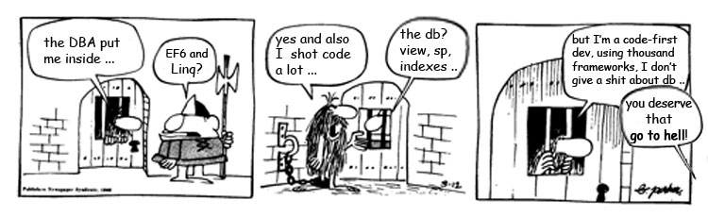
The SQL wrote from “others”
Sometimes things can happen when the db is only a storage
0

Slide 18

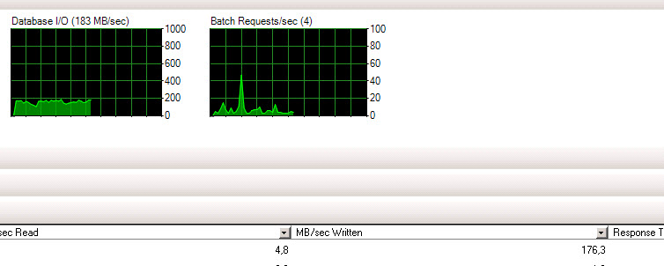
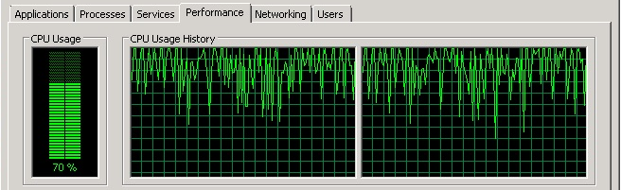
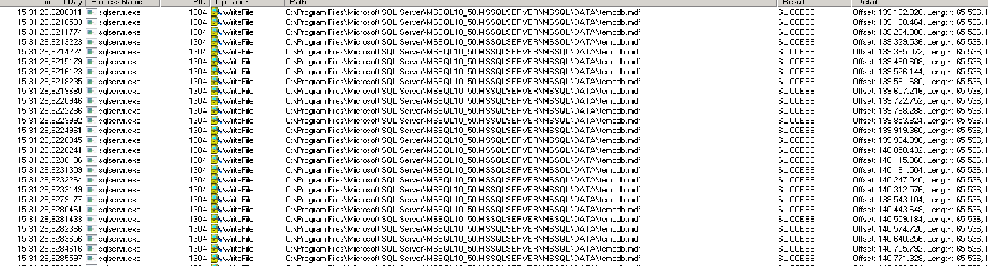
The SQL wrote from “others”
var something = from item in MyEntities.Collection
where groupId == null or item.groupId == groupId
select item;
200MB/s

Slide 19
DEMO Entity Framework filtering client/server side extracting data, debugging

Slide 20
Conclusions
Now you can use and mantaining indexes
Analize consistency between tables and fields
Make friends with analysis tools (profiler, query plan, ..)
Have a Row-Set approach
Supervise the work of «others»
To be «stingy» when you are extracting data
List of ideas for improvement
Analisys
Approach
Stingy
Supervise
Make friends
Indexes
test .. test .. everytime

Slide 21
Q&A
Questions?
ezanchettin@thinkit.it
@_thinkIT_
Here, there, around the world

Slide 22



Feedback
Please return feedback on
thank you!

